Slide 1
Introduction
LO: IWBAT to use P5-JS to create my very own first program.
Notes:
7-8.CT.7
Design or remix a program that uses a
variable to maintain the current value of a
key piece of information.

Slide 2
WARM UP:
Play a game of Tic-Tac-Toe with a partner next to you.
What are the rules of the game?
What parts of the game are needed?
How do you determine the winner?
Notes:
Have students discuss their answers and what this would look like in a program.

Slide 3
Unit Plan
Game Based
P5-JS
By the end of this unit, you will be able to create a game like Tic-Tac-Toe on your device.
We will be programming in Javascript with an online editor known as P5-JS.

Slide 4
Tic-tac-Toe
https://editor.p5js.org/cs4all/sketches/Bk3TOJzlE
Here’s an example of what your game could look like
Notes:
Go to website and play a game against a student. Show them the code and let them know that they can be creating this. Explain to them that a program has multiple parts, just like how we broke down the rules of Tic-Tac-Toe in the warm up. We will learn the parts bit by bit, so that we can create a game like this.
Ask: What skills do you think we will need to be able to create a game like this?

Slide 5
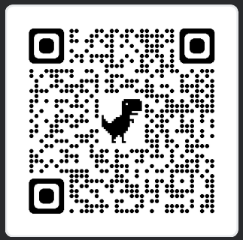
P5-JS
https://editor.p5js.org/
Go to this website.

Slide 6
P5-JS Setup
01
02
03
04
05
06
Sign Up
Login
Google
Click Sign up on top right corner
Click Login with Google
Choose your School Google account o log in with
Title
Save
Questions
Click the pen button next to the title and change the title to “Introduction”
Click file and then save.
Ask any questions if you have issues setting this up.
Notes:
Walk students through signing up for P5-JS. You can demo it for them.

Slide 7

Hello World
One of the very first programs that programmers create is a printout of “Hello, World!”
We will do just that in Javascript.
Delete all the current code on the screen.
Type in the following:
  document.write('Hello, World!');
You should see a line of text that says “Hello, World!”
Congrats! You have created your 1st program
Notes:
Feel free to live code this for students

Slide 8

Comments
One of the best practices in coding is commenting your code, so that you and others can read very quickly what those lines of code do.
To do so, use “//”
Please comment out your code for “Hello, World!”

Slide 9
Variables
A variable is a named location that stores a value.
Values may be numbers, text, images, sounds, and other types of data. To store a value, you first have to declare a variable.
All JavaScript variables must be identified with unique names.
These unique names are called identifiers.
Identifiers can be short names (like x and y) or more descriptive names (age, sum, totalVolume).
JavaScript variables can hold numbers like 100 and text values like "John Doe".
Strings are written inside double or single quotes. Numbers are written without quotes.

Slide 10

Variable Example
Name
Store your first name as “firstName” and last name as “lastName”
Print
Print your first and last name on separate lines. Use “<br>” for a new line.
Notes:
Show students how to print statements in new line using +”<br>”. Note that using a plus sign is known as concatenation and you can do something similar by adding your names together.
Have students try to print their names. Walk around and take note of any misconceptions, such as missing semi-colons.

Slide 11
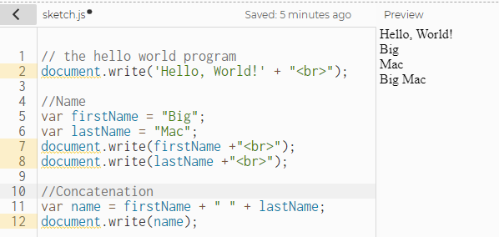

Slide 12
Exit Ticket
Biography
Using all the skills we learned today (variables, strings, print statements, comments, and concatenation). Write a brief summary about yourself. This could include:
Age
History
Hobbies
Likes/dislikes
etc

